Slide 1

Friends of Kensal Rise Library Volunteer and Patron workshop
28 February 2026
Prepared for advisory purposes only. No responsibility or liability is accepted for decisions or actions taken based on this content.

Slide 2
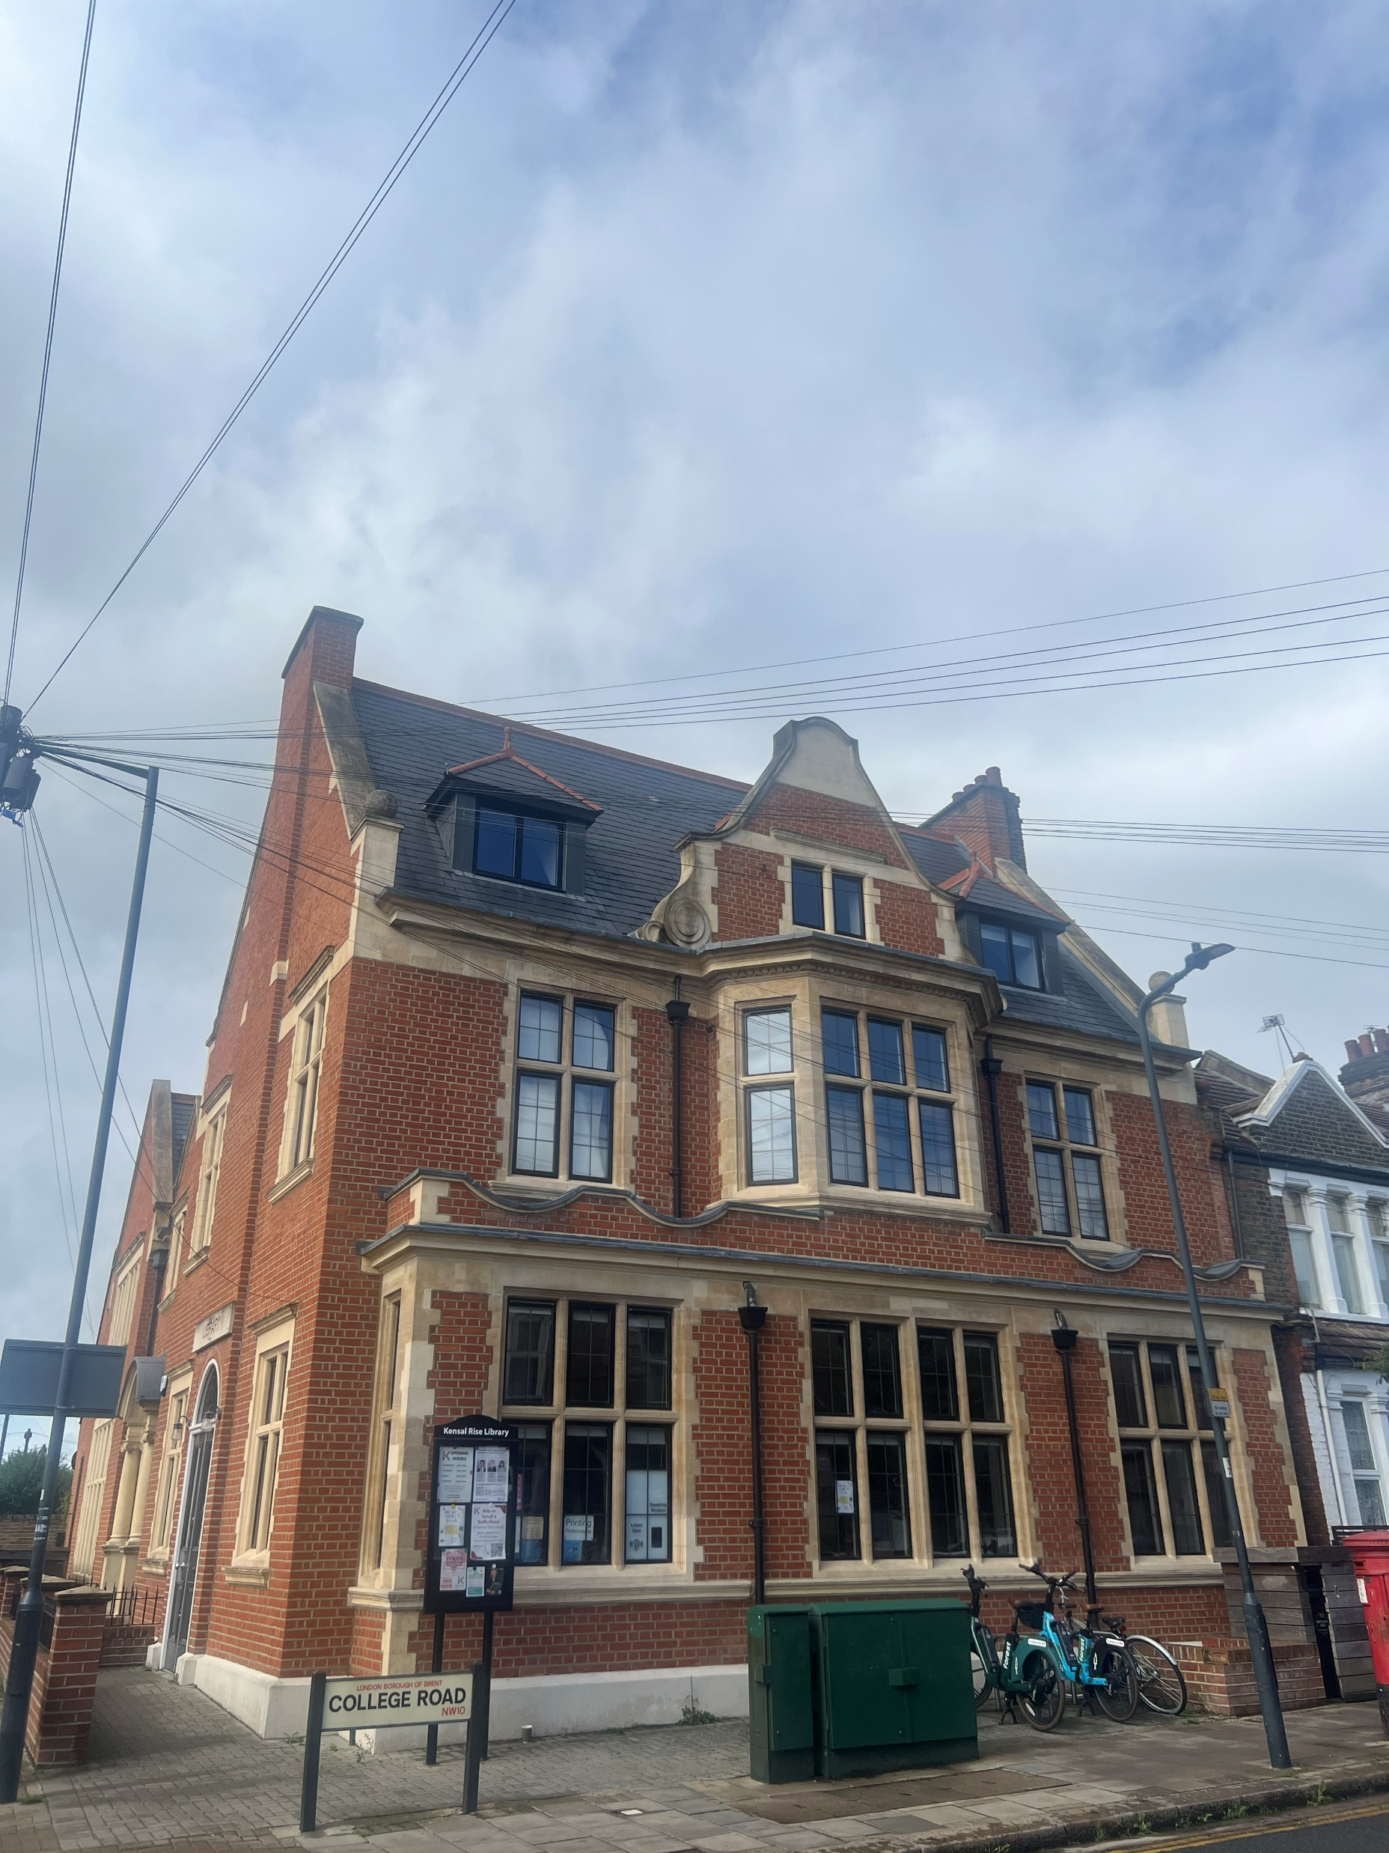
What the session covered
Summary of:
Report findings and recommendations
Outcomes of board workshops
Shared proposed vision, mission and strategy with workshop attendees
Feedback from attendees about the vision, mission and strategy
Outline of next steps
Disclaimer
This presentation has been prepared on a voluntary basis to support the strategic and operational development of Kensal Rise Library. It is intended solely for advisory purposes and reflects the author’s independent analysis and recommendations based on available information and stakeholder input at the time of drafting. No responsibility or liability is accepted by the author for any decisions made, actions taken, or outcomes arising from the use of this presentation and related report. Readers are encouraged to seek appropriate professional advice before acting on any of the content herein.

Slide 3
Agenda for today
Topic | Time | Lead
Welcome | 5 min | Charlie
Overview of what we’ll cover | 5 mins | Sian
Reminder of context: 2025 survey findings and actions | 15 mins | Siân
FKRL vision for the future | 15-20 mins | Siân
Volunteer and patron reflections about the vision, mission and strategy | 15 minutes per station | 10-minute break after first rotation
Share back | 5 mins each
Next steps and close | 10 mins | Charlie and Siân

Slide 4
Agreed FKLR vision statement
The beating heart of your connected, creative community
- Run by you
Prepared for advisory purposes only. No responsibility or liability is accepted for decisions or actions taken based on this content.

Slide 5
Current mission aligns well with the proposed vision
Mission statement:
To maintain an innovative exciting library and public space at the heart of our neighbourhood that is free and welcoming to all, offering a range of services for both adults and children to further literacy, the arts and community cohesion.
Prepared for advisory purposes only. No responsibility or liability is accepted for decisions or actions taken based on this content.

Slide 6
Strategy
Trustees agreed that the FKRL four core aims provide strategic direction in line with the vision:
1. To promote literacy and lifelong learning
2. To provide free access to information
3. To support community health and well-being
4. To encourage engagement, creativity and the realisation of potential
Prepared for advisory purposes only. No responsibility or liability is accepted for decisions or actions taken based on this content.

Slide 7
Over to you
VISION
How do you feel about the vision?
What would it look like if this vision comes to life?
What would be the same? Different?
What will volunteers, Patrons and community see, feel and experience?
What opportunities do you see for volunteers and patrons to contribute to bringing this vision to life?
What concerns or questions do you have?
MISSION
How do you feel about the mission?
What ideas do you have for how we can bring it to life?
What role can volunteers and patrons play?
STRATEGY
Do you agree that our priorities serve well as our strategic direction
What excites you about them?
For each of the four strategic areas, what practical actions or initiatives would make the biggest difference?

Slide 8
How do you feel about vision statement
Positive reaction to “creative” and “connected”; differentiators
Change “your” and “you” to “our” and “us”:
What does “run by you” mean? Unpack that
Importance of communication/transparency in vision and strategy
Why important: can refer back to 90%
Beating heart: pro-active, 21st century library
Some people less convinced by “beating heart”, could be “active hub” instead?
Future of libraries: hubs, beyond books, skills
Change to “our”
“Active hub” suggested
The beating heart of your connected, creative community
- Run by you
Change to “us”

Slide 9
What would it look like if this vision comes to life?
Need more events, not just literature, need to be inclusive eg games for young and old
Make it clear that anyone in the community can start an activity
Get the word out about the library
Importance of getting the word out and communicated
Use Brent CVS more to advertise
How to use social media more effectively: Facebook and Instagram pages should display FKRL vision, mission and strategy as well as what’s on
Flyers @ local shops
Partnership s with schools: more ads at schools; maybe run a project for school to promote the library
“Open”: what would it look like?
Always something on eg every night/day. Expectation that open five days/week – regularity is key and builds a sense of community
How to make this happen: evangelise, leaflets to be delivered
Could this motivate people to volunteer regularly
Open in holiday periods
Reduction in paid hire
Target different teens: event/space
What are the 1600 patrons interested in?
Have a community get together three times a year/smaller and larger events

Slide 10
What opportunities for volunteers to bring the vision to life
Make it clear that there are different kinds of volunteers: come and help the library but not necessarily as a shift volunteer
Run a competition to boost volunteer numbers up/prizes for volunteers from local business
Find out what times volunteers have available
Translate patrons to volunteers – pyramid

Slide 11
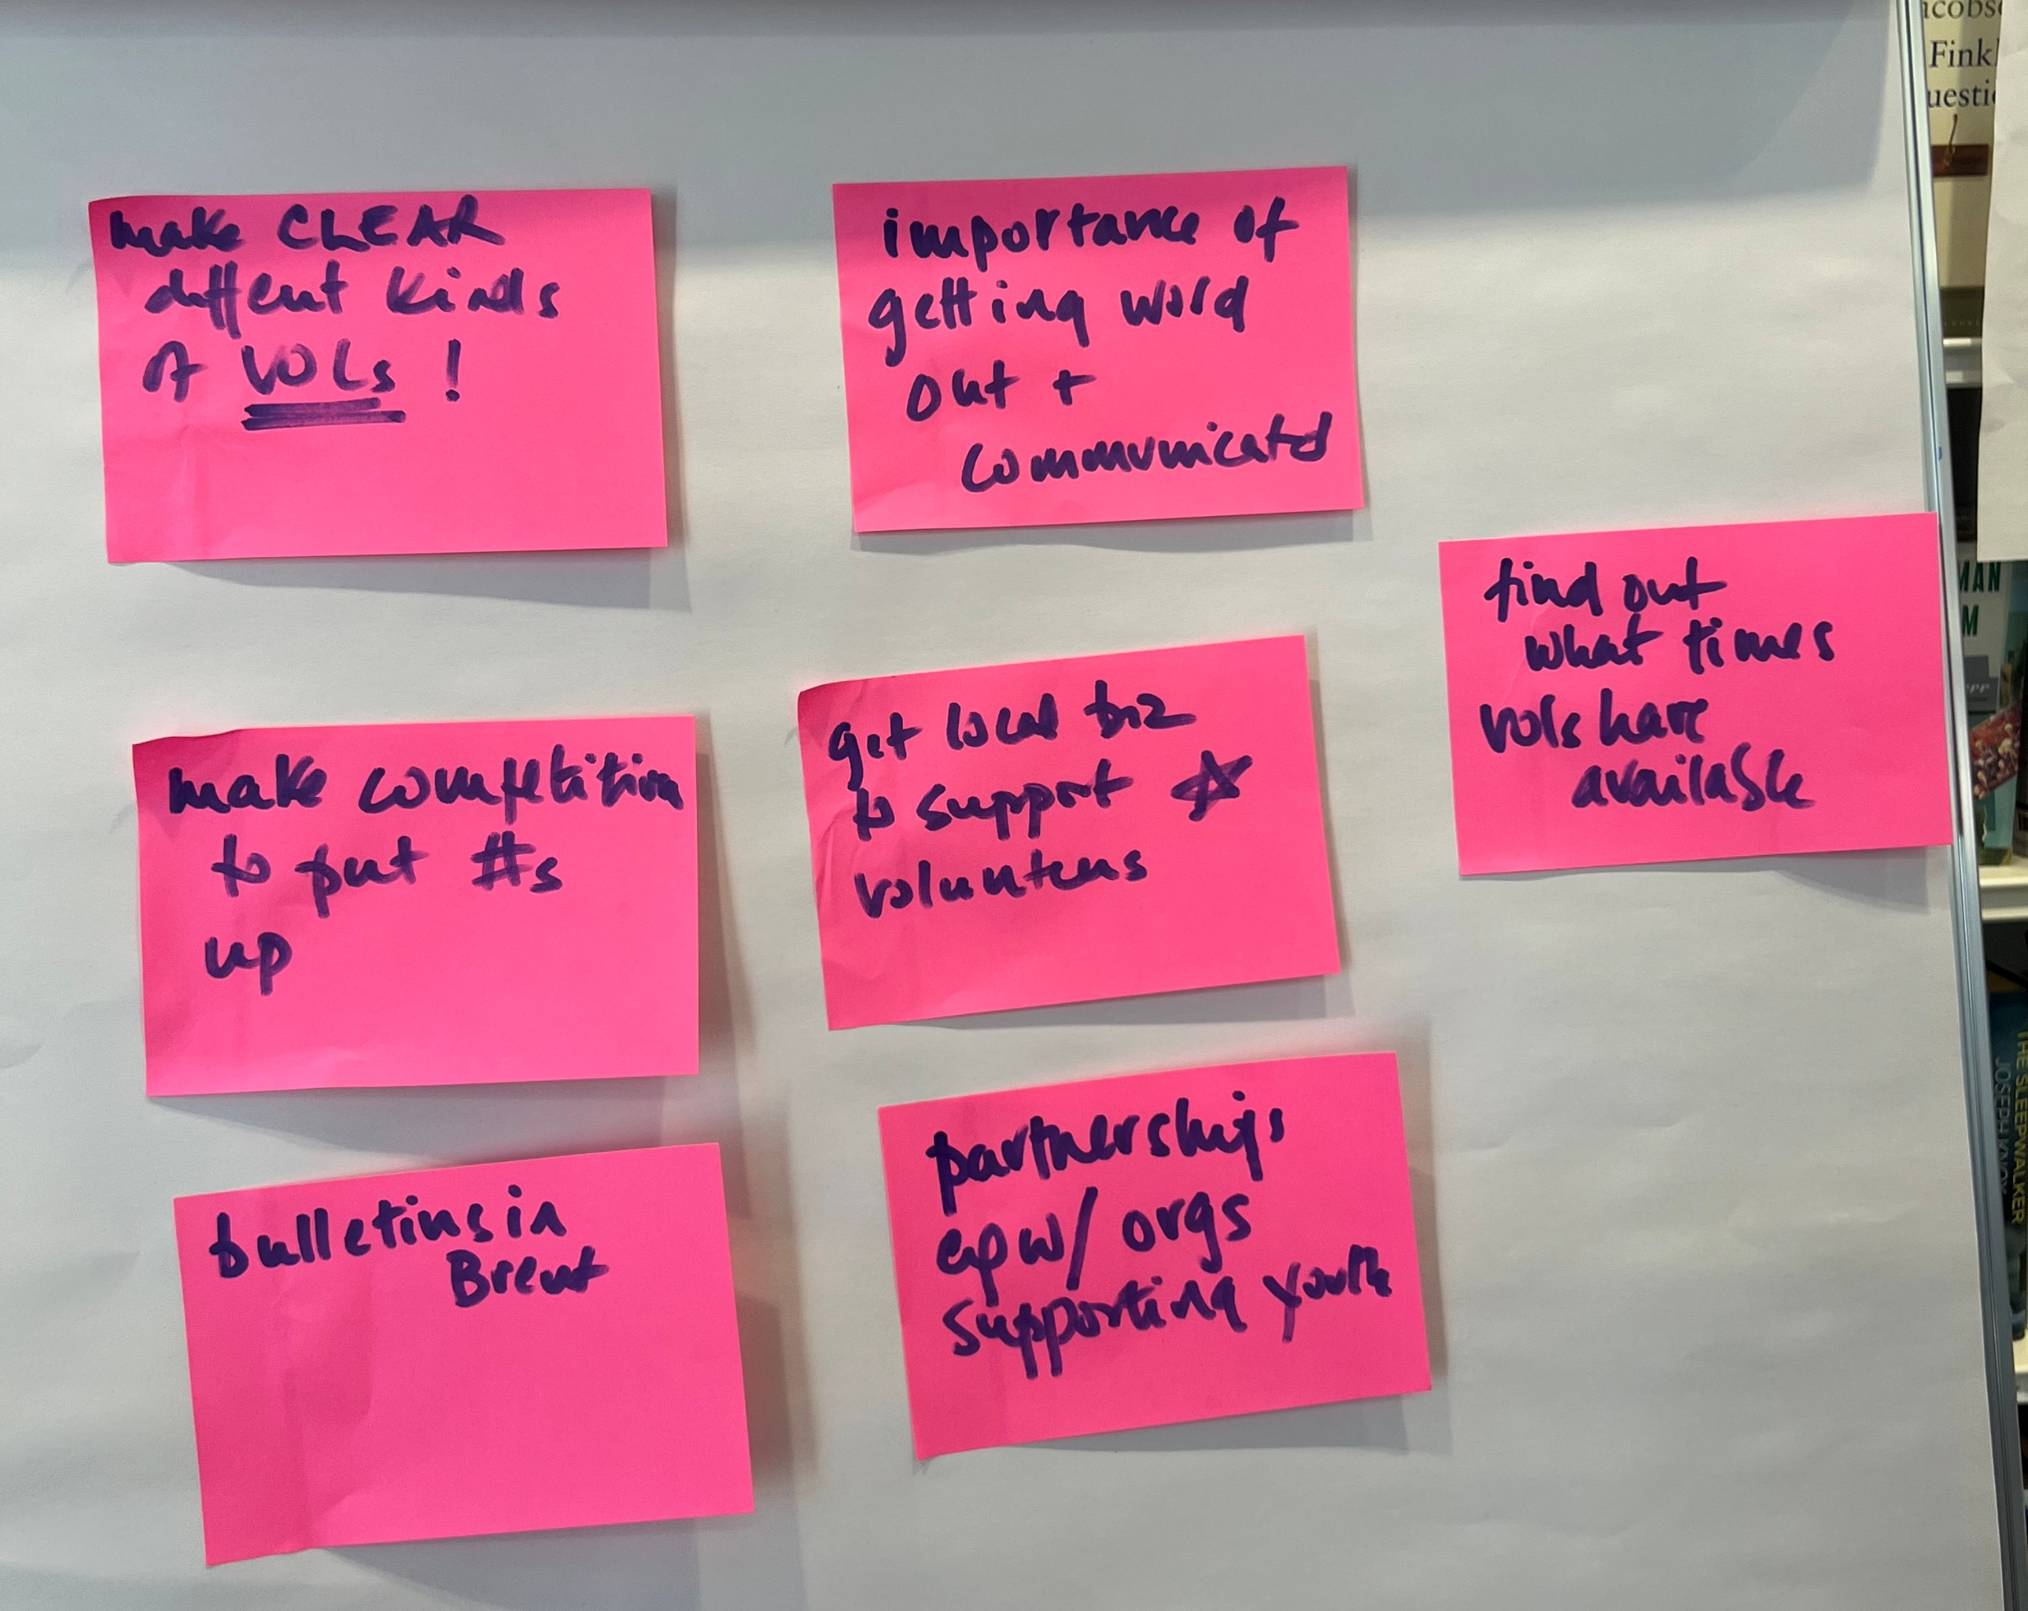
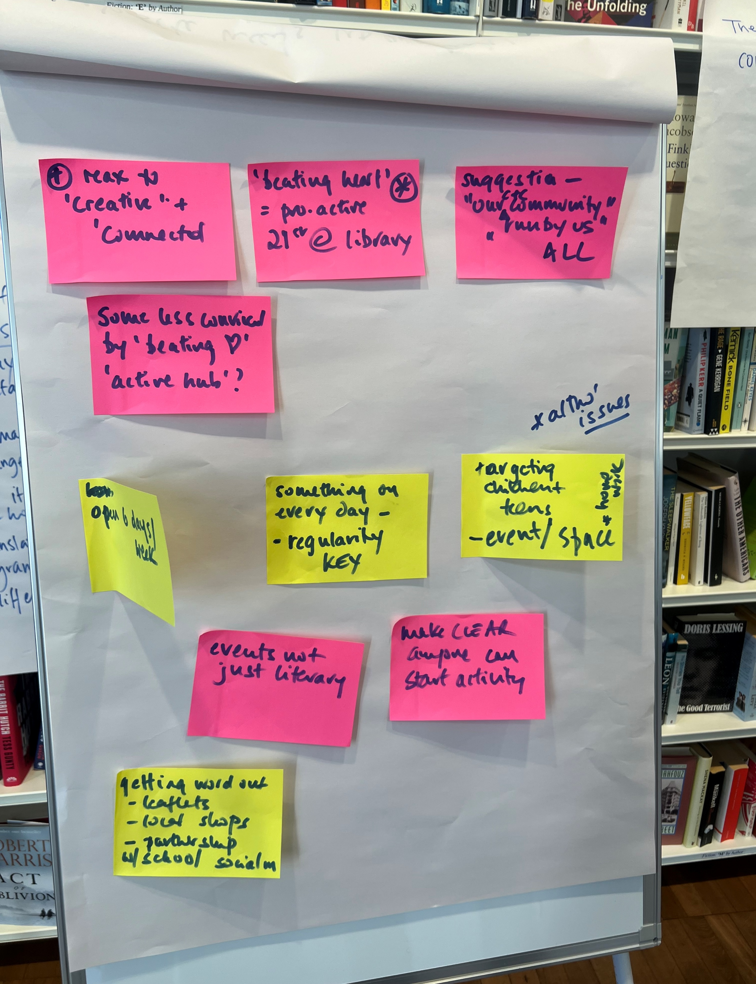
Images of vision feedback flip charts

Slide 12
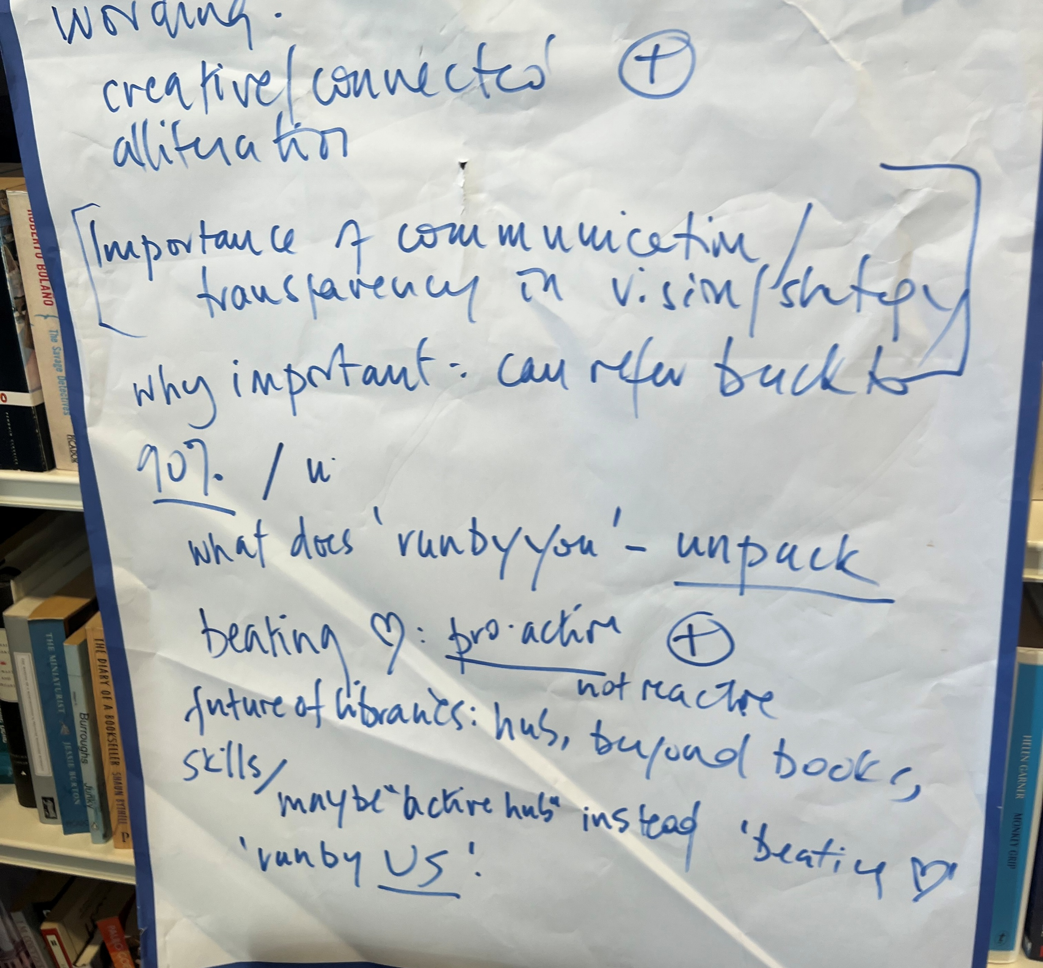
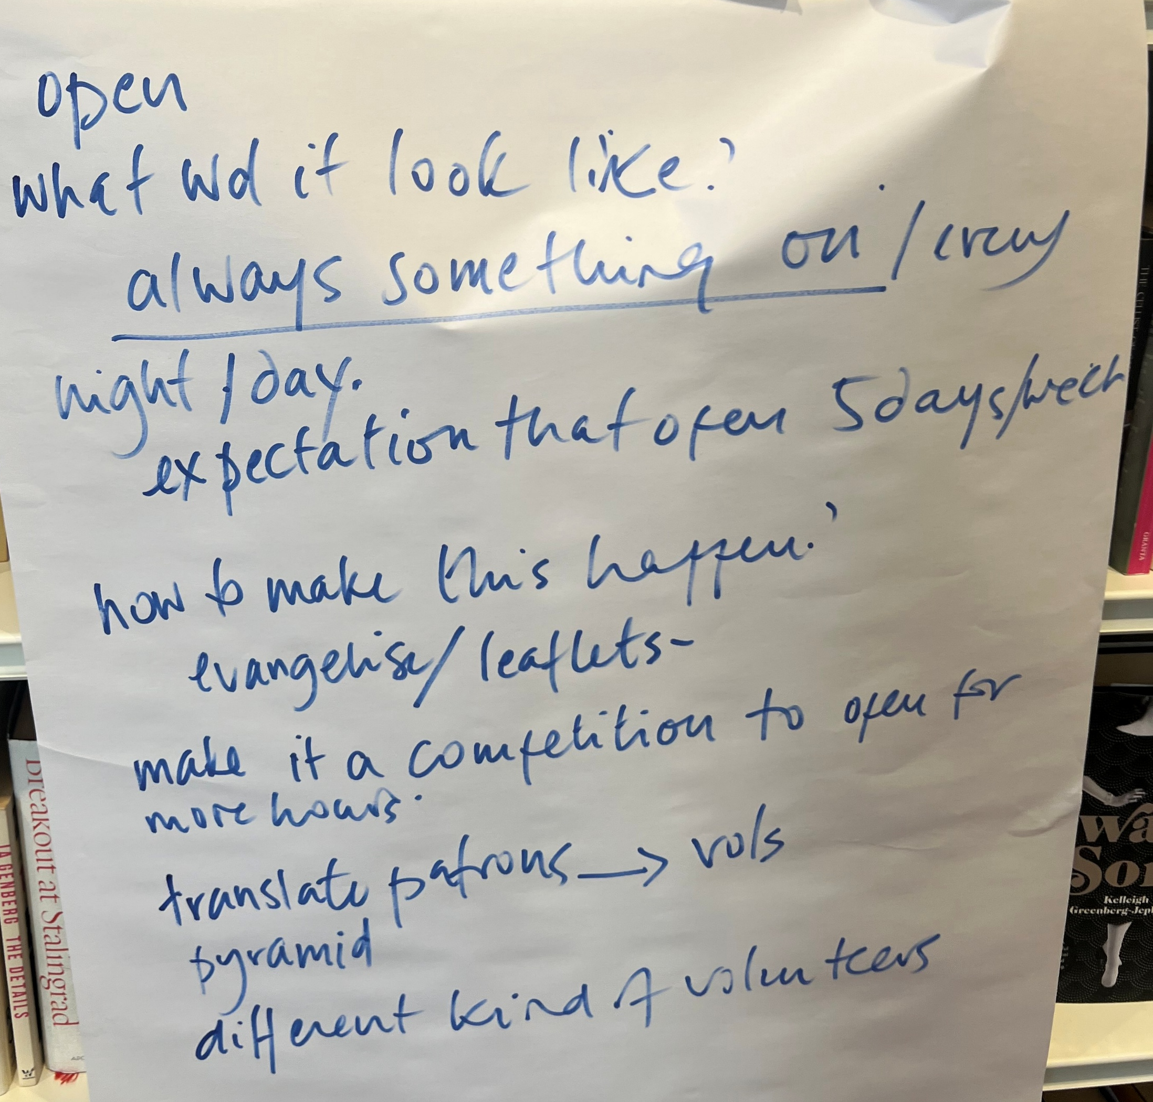
Images of vision feedback flip charts

Slide 13
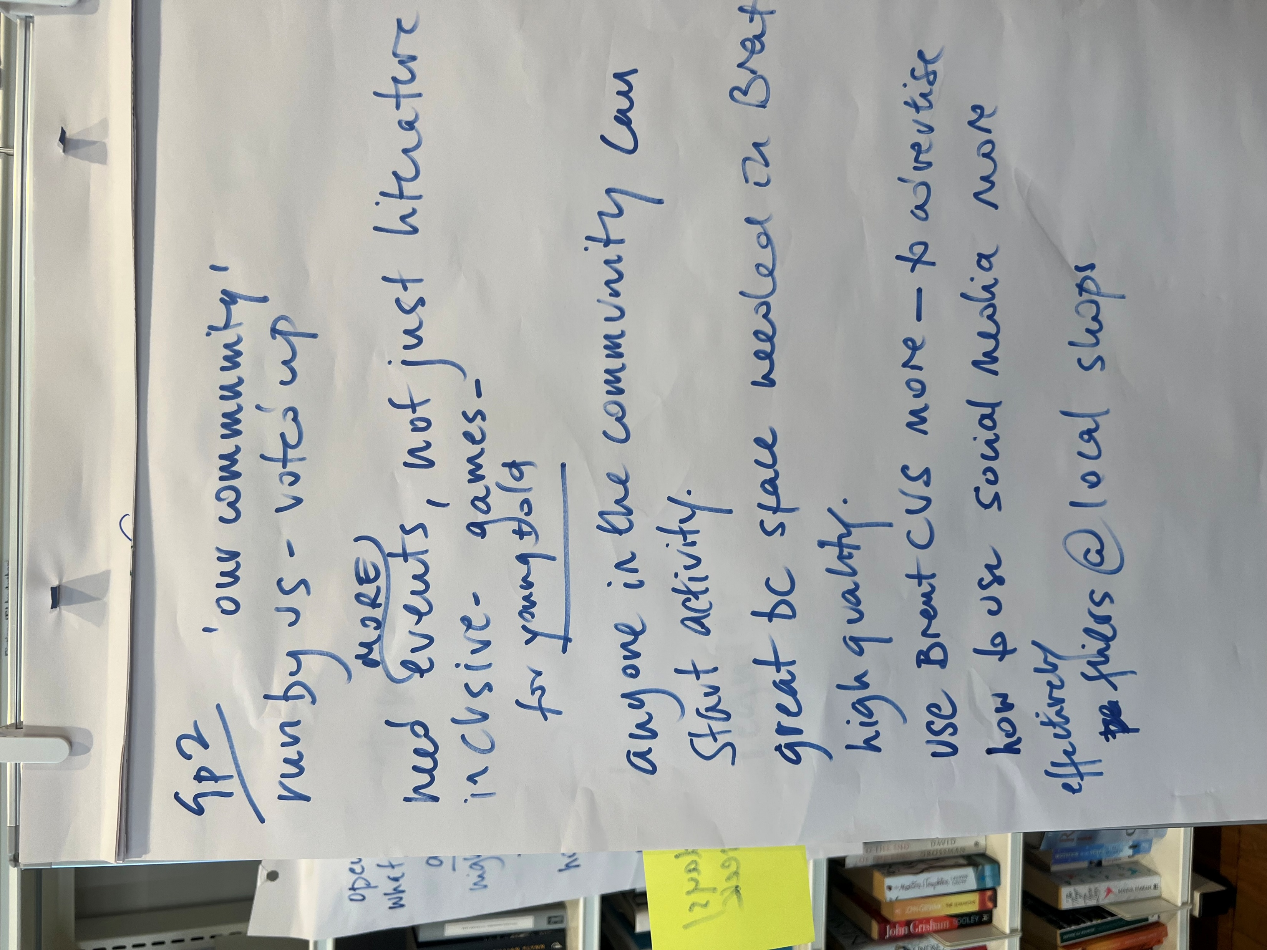
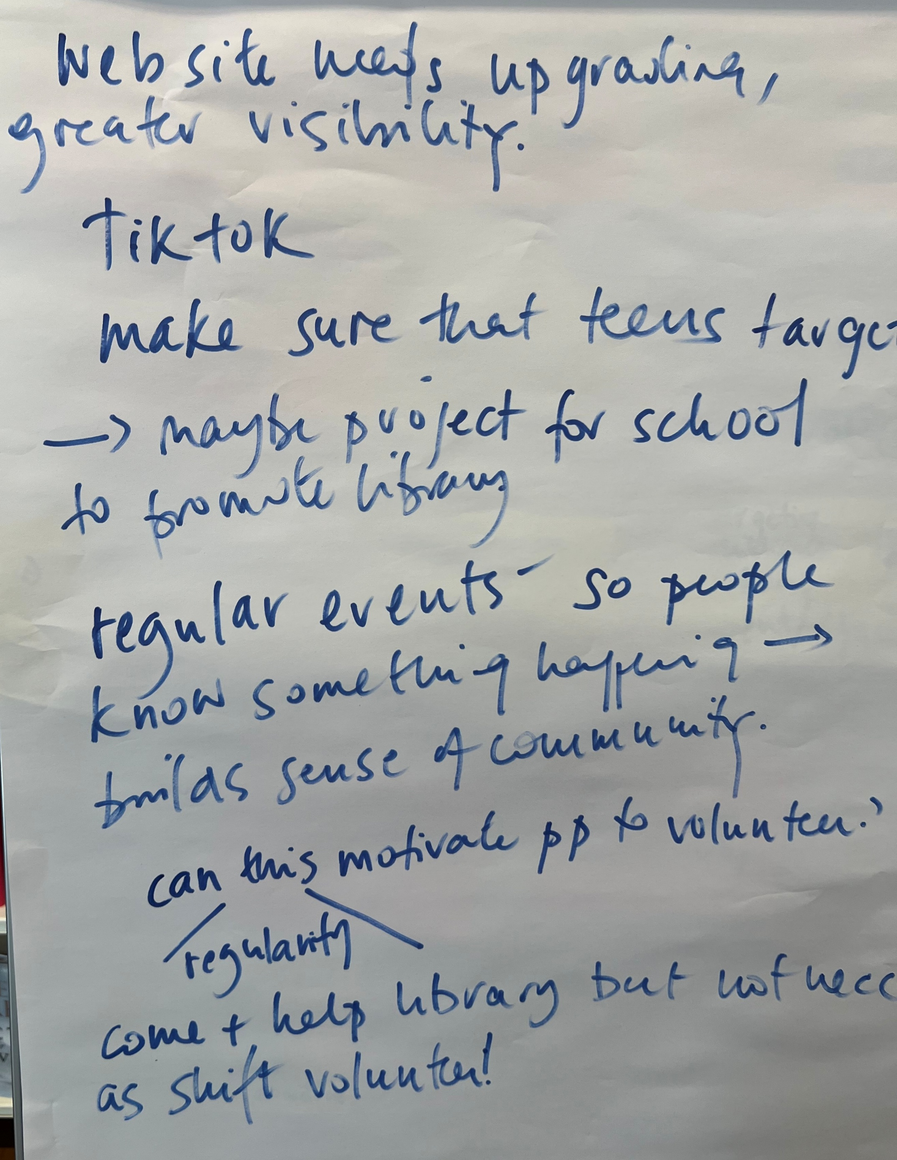
Images of vision feedback flip

Slide 14

Mission statement: how do you feel about it?
Overall positive feedback about the mission statement
Participants liking it and feeling it resonates with them
“Exciting” – are libraries exciting? Could be replaced with “dynamic”.
“Innovative” seen as an overly-used word and not clear what it means for the library. Define what this would mean for the library or remove/change.
“Literacy” could be extended to include “learning” and “oracy
“Maintain” seen as weak/passive. Could be changed to “nurture”, “Grow” or “enhance”.
“Welcoming” could also be enhanced with the word “inclusive”.

Slide 15
Mission: what ideas do you have for how we can bring it to life?
Need to make people aware that the library is free to join
Ramp up outreach, evangelise the library, distribute flyers
Use social media and street WhatsApp groups in the area
Library needs to be physically open and indicate it’s open
Ensure the lights are on when it’s open
Signage outside when it’s open or events are taking place
Remove barriers to coming to the library: great work done on making the library accessible to disabled people, is there anything more we could do?
Install a box outside for book returns (opening hours are a barrier to some people returning books on time)
Events/community engagement ideas
Keep running the Chatty Café and other activities
Re-activate school visits (library might need to be open in the mornings)
Descriptor cards on more books
More children’s storytelling sessions, run nursery rhyme sessions
Run a monthly art competition
Readings by local writers of their work
Annual book festival
Don’t underestimate the value of having a quiet space for study
Use the Dave Williams room more for students to study and do homework.

Slide 16
Mission: what ideas do you have for how we can bring it to life?
Put up the timeline of library successes/recent history on a wall as a display with photos/images to celebrate all that we’ve achieved
Partner with local businesses and organisations
Identify overlap and synergy
How can we signpost to them and vice versa and collaborate?
Local businesses can be sponsors but we can form deeper partnerships with them – how can we help them?

Slide 17
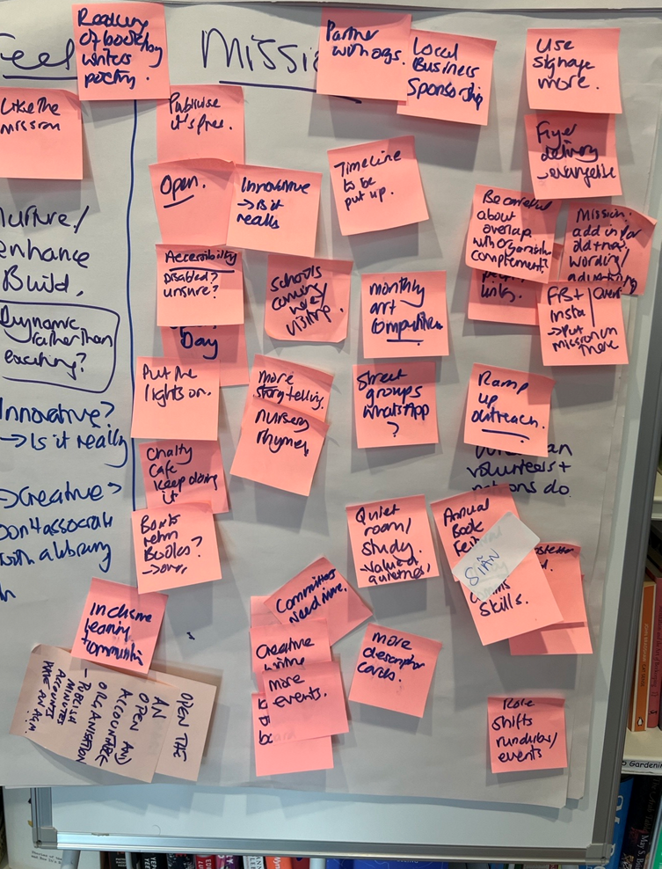
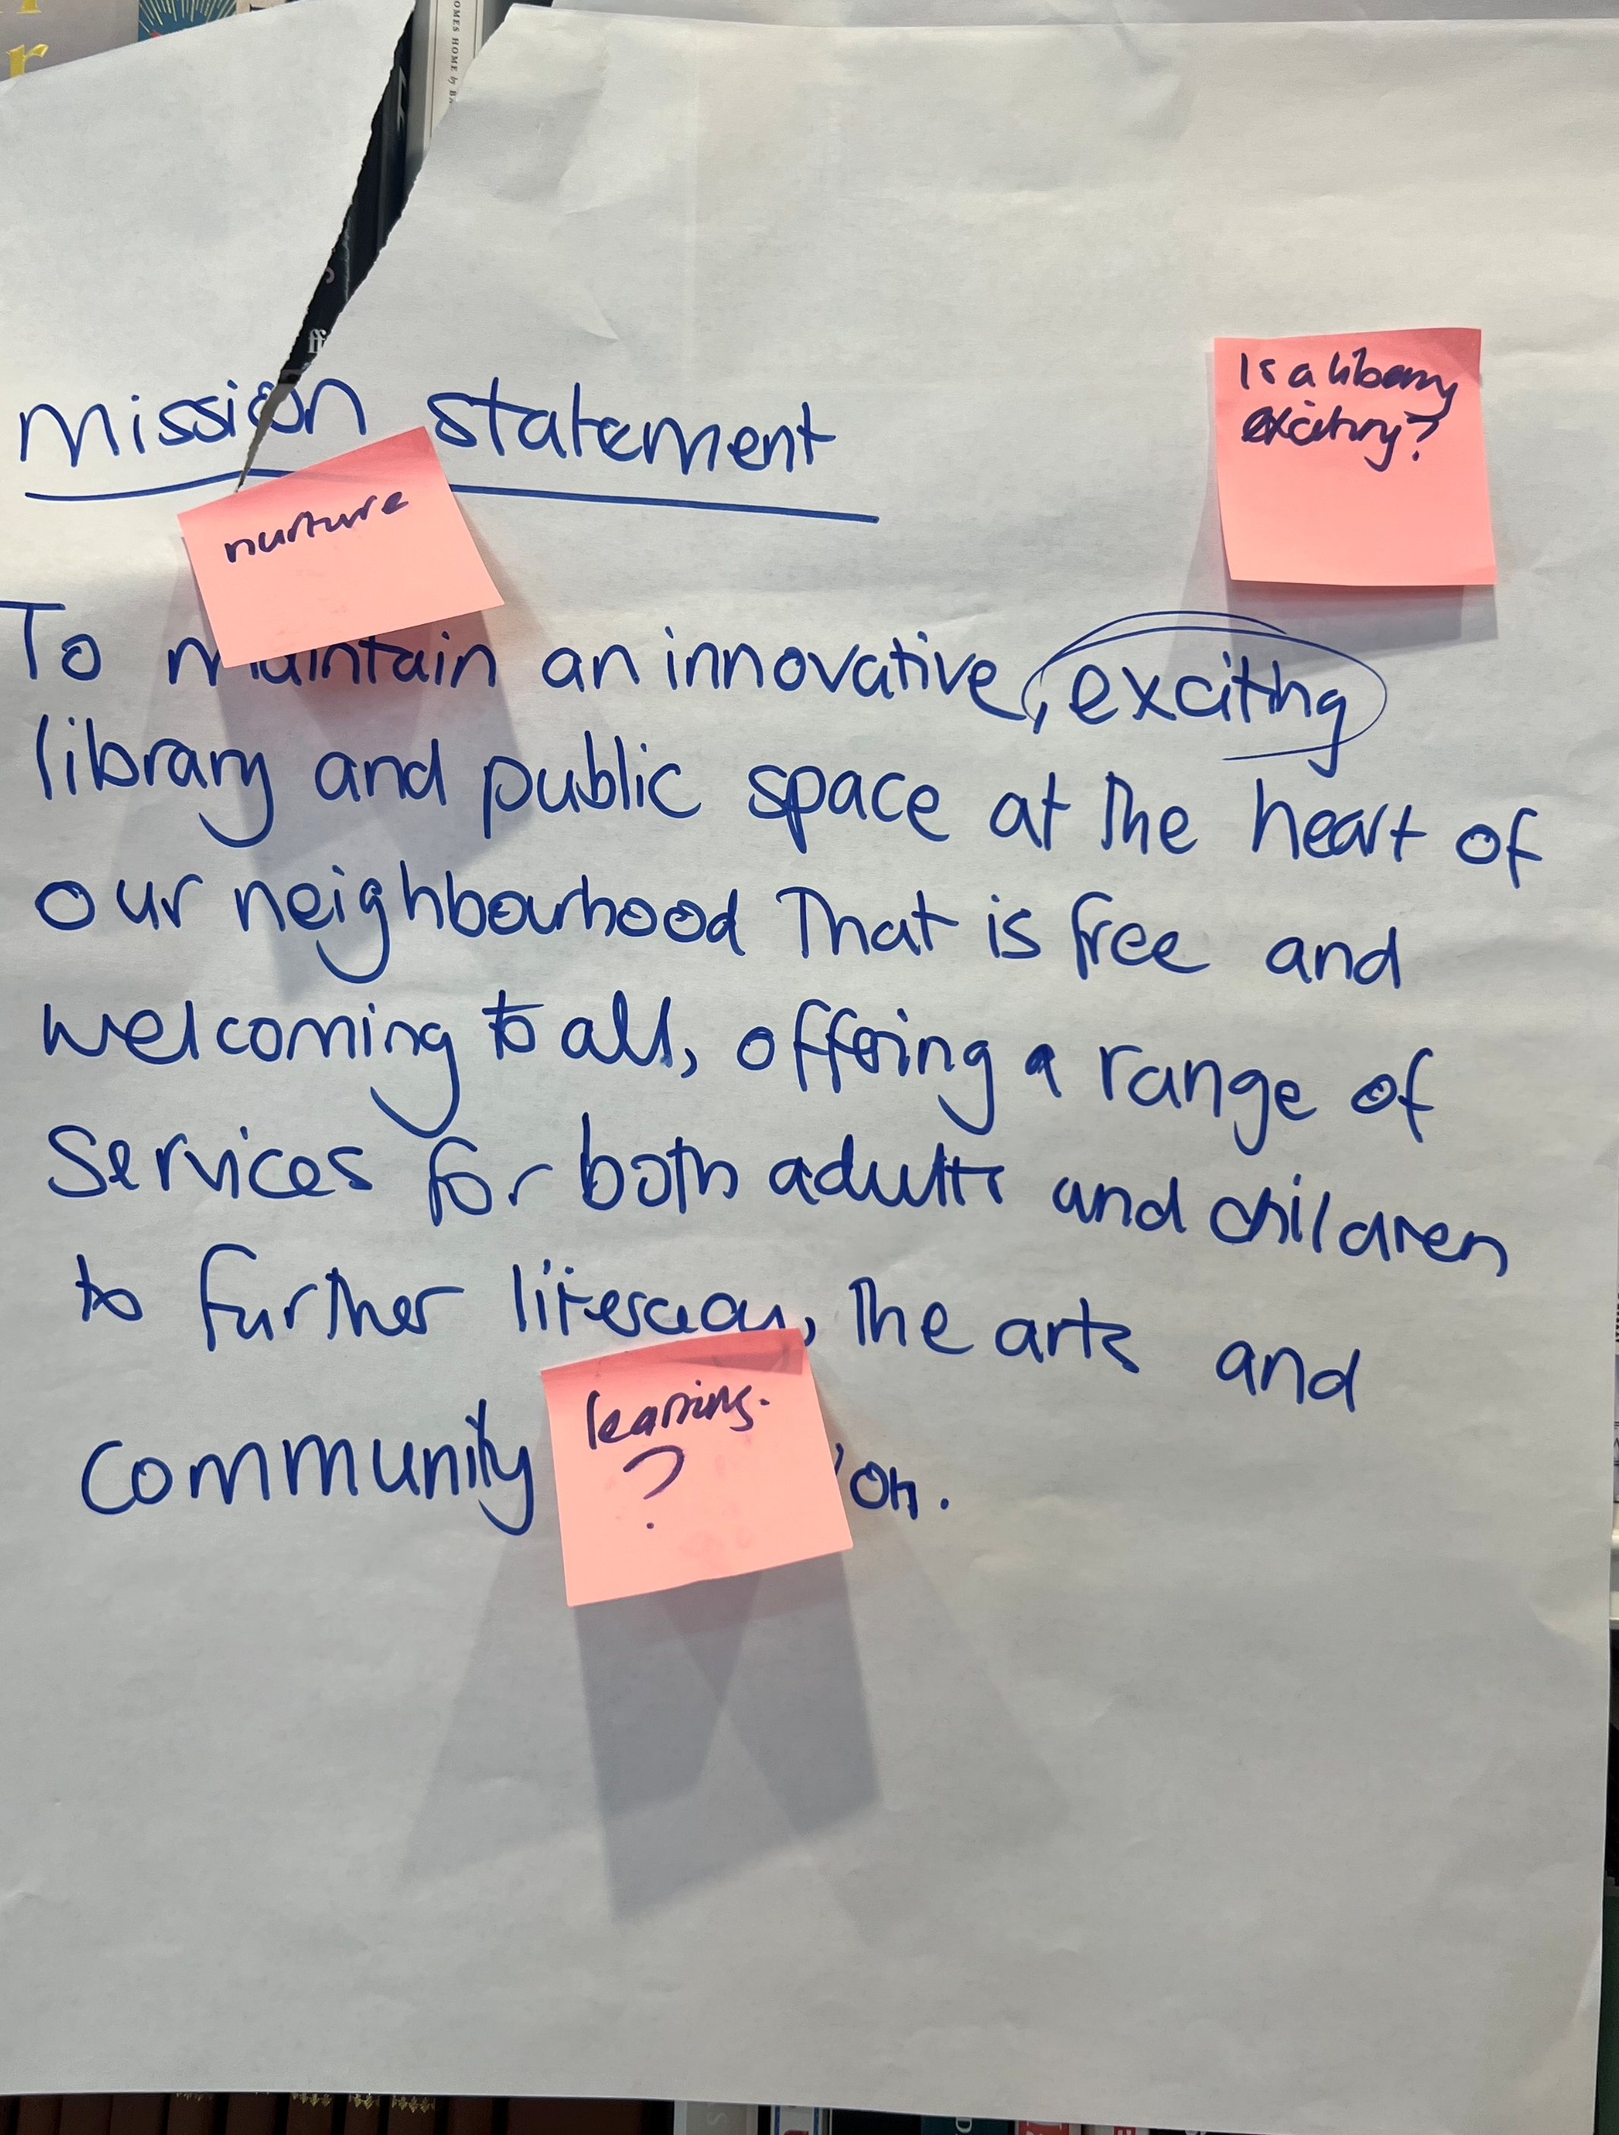
Images of vision

Slide 18
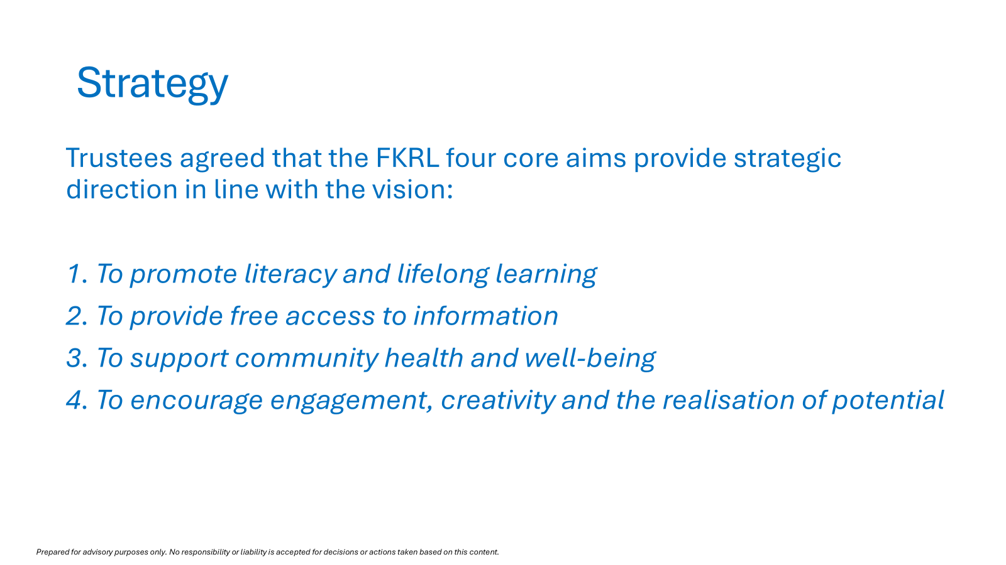
Strategy: feedback about the four pillars/wording
“Community”missing from three of the priorities
Include “oracy”
What does the library add to the community? Lose the top 3 in the strategy as not unique
Is “community health” too much of a divergence?
Take out health
Who is the community?
What does “realisation of potential” mean?
Missing in this: quiet place fo thought and study

Slide 19
Strategy: what practical actions or initiatives would make the biggest difference?
Operationalise the strategy:
Link each point of the strategy to a project
Smart goals for each strategic pillar
Hold an AGM to update on usage, volunteer hours, finances etc.
Timetable of what the library is working to
Skills matching
Don’t over-promise on what we can deliver
Should the library be a co-operative instead of a charity? Is charity the best operating model?
Books committee working well, what other committees should we have/are running? Eg events committee?

Slide 20
Strategy: what role can volunteers play in bringing it to life
For the library to be well run, volunteers need to feel a collective sense of responsibility for the library and empowered to take day-to-day decisions and listened to before trustees take strategic decisions.
Good two-way communication between the trustees and the volunteer community is essential :
Volunteers would be more involved in strategic decisions
Information could be shared
Trustee/volunteer consultation could take place
Discss jobs that need doing, who can do what, suggest ideas and develop and progress them
Volunteers need to know and trust each other to do great things
Volunteer forum: good place for new people to come meet others and feel part of something.

Slide 21
Strategy: ideas of initiatives and activities that would make the biggest difference
Pre-exam homework club – use the Dave Williams room for this
Brent Health Matters and Citizens Advice outreach
After school clubs
How do we reflect the community?
Books in foreign languages, how do people find out about the selection on offer?
Duke of Edinburgh Award: volunteers come together, need a project to work on
Local councillors hold surgeries here
More smaller groups organising:
How are we asking volunteers to get involved?
Websites better than social media

Slide 22
Strategy feedback re communications/advertising/promotion
Need effective means of communication between different and overlapping groups: trustees, volunteers, library users, wider community
More posters in the window
Social media local sites, more publicity
Flyers
Local school newsletters
More accessible website
Adverts in local shops
Suggestion made of stronger brand/visual identity eg font/colour palette
Marketing project could be run

Slide 23
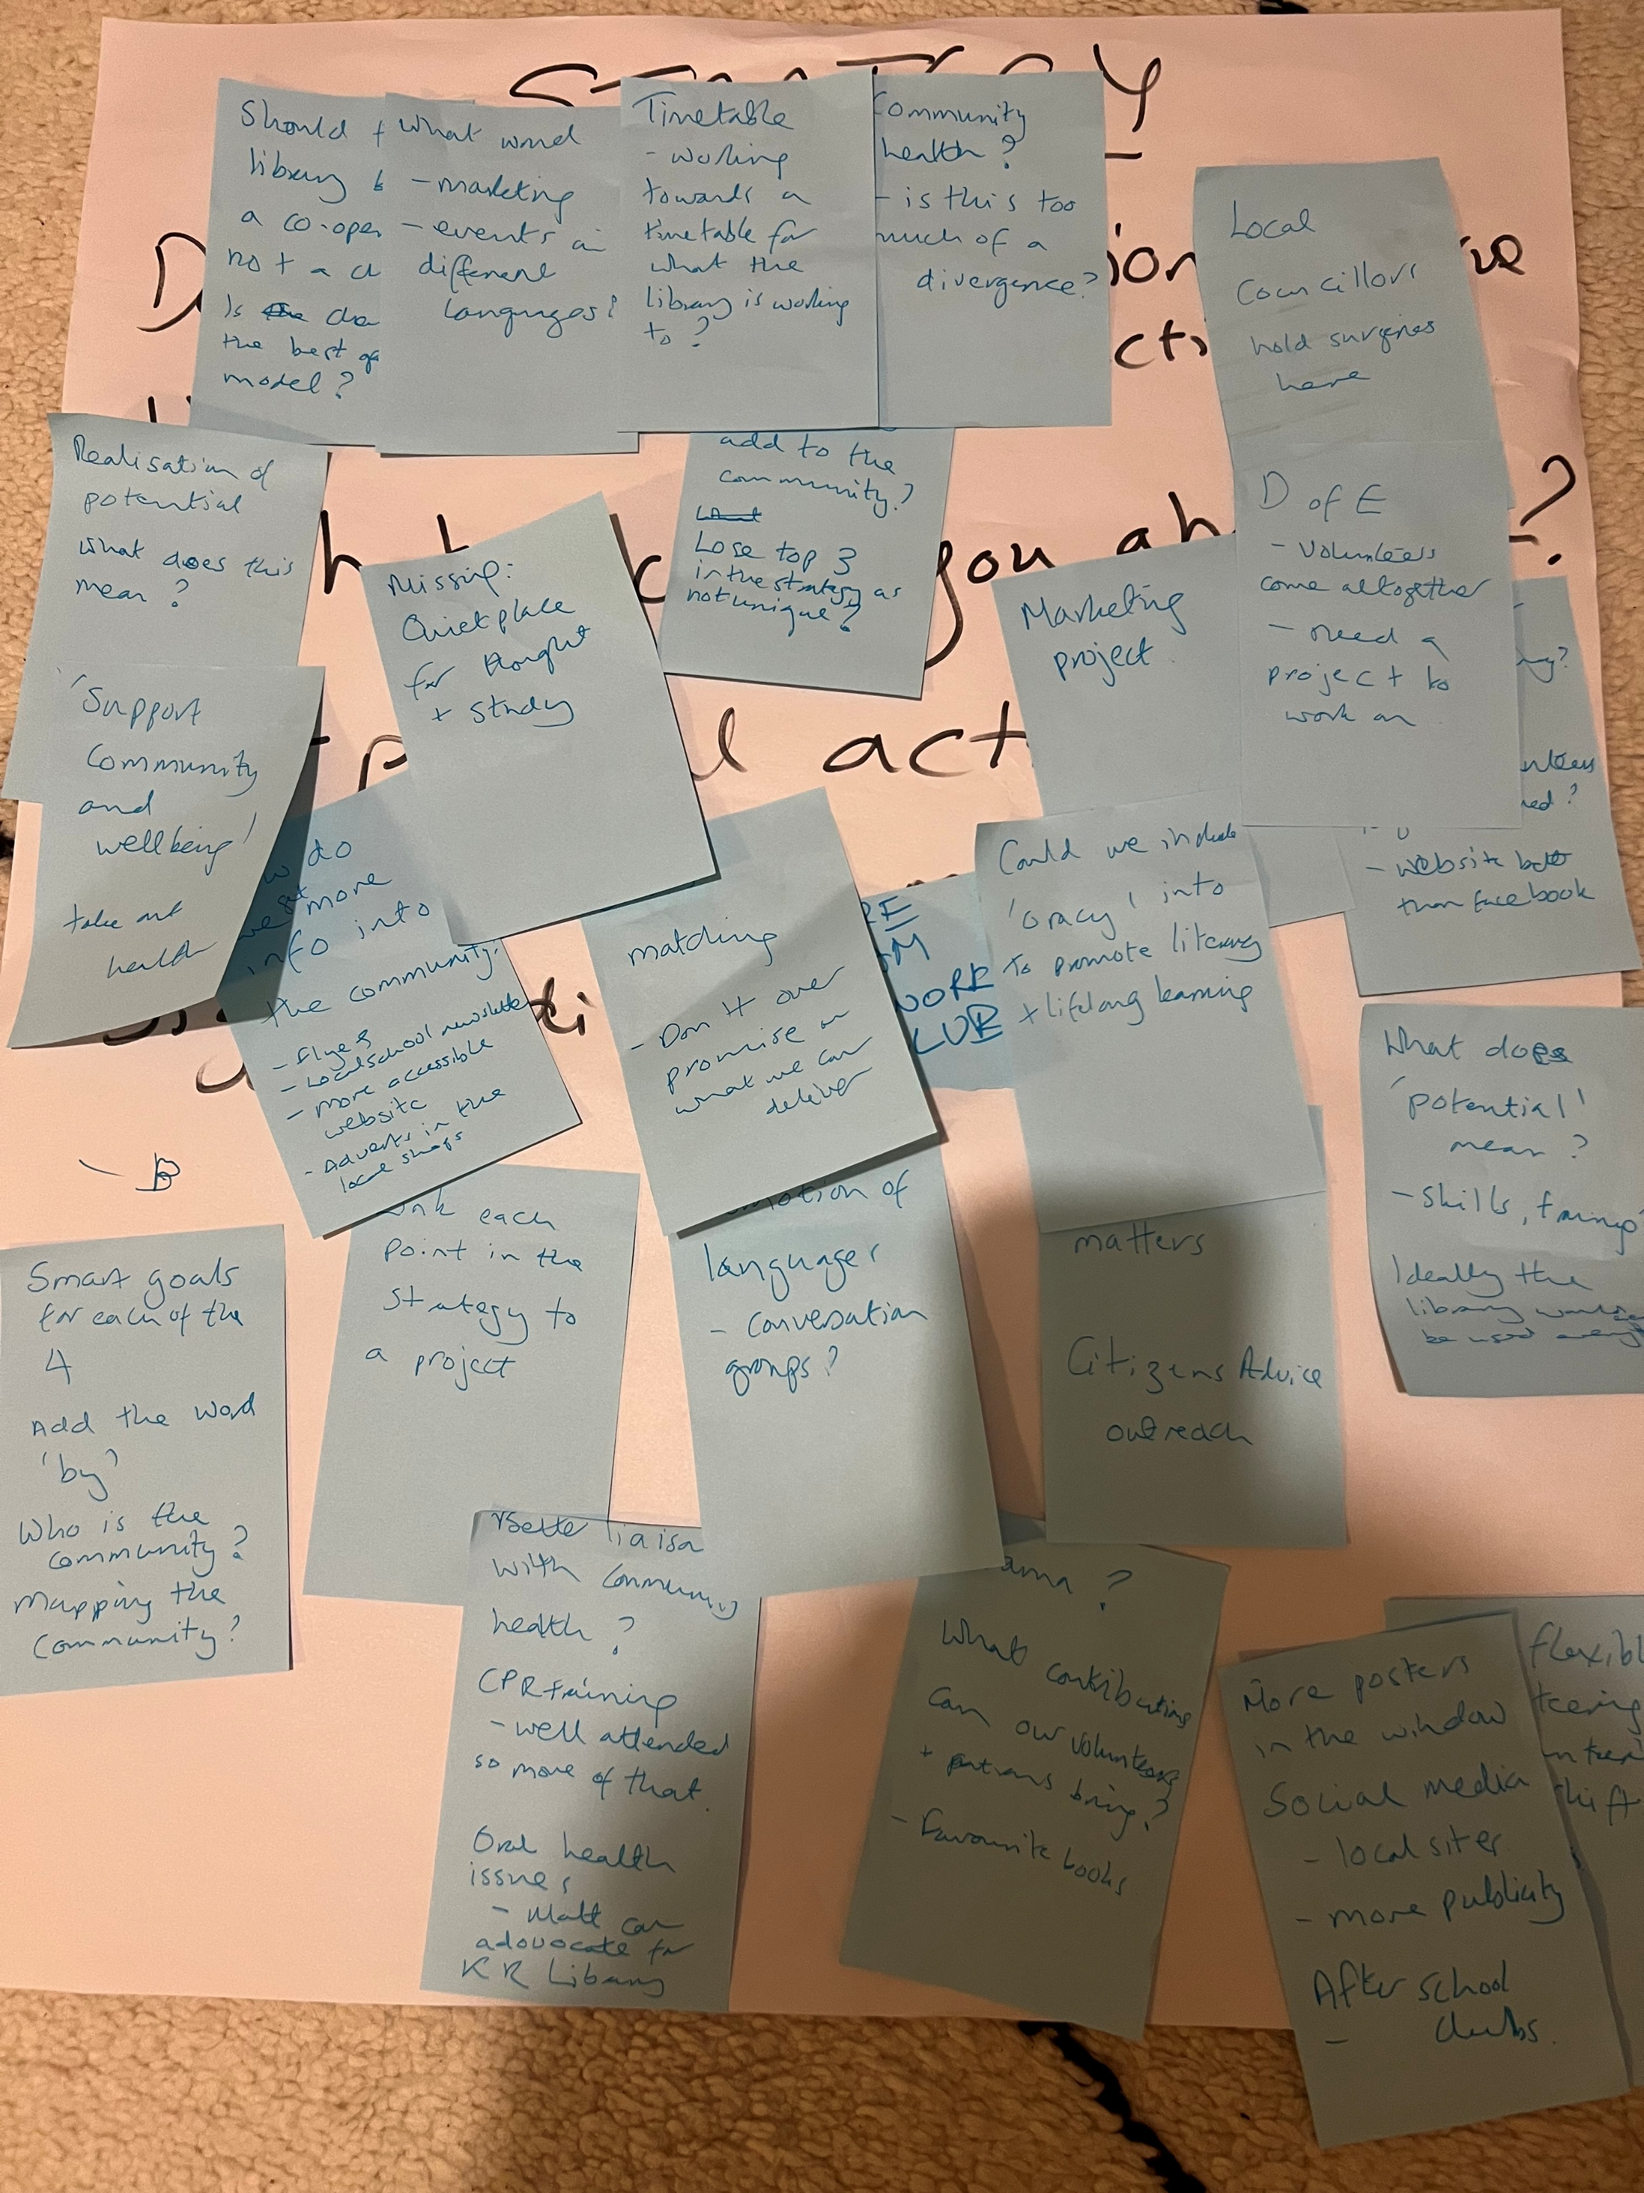
Strategy flip chart feedback

Slide 24
Summary of feedback
Overall positive feedback and alignment with the vision and mission statements and strategic priorities with suggested tweaks/refinements
Feedback falls into four areas:
Accessibility and visibility
Library to increase opening hours and raise awareness that it exists, is free for people to use and what it offers.
Library needs to be visibly open: turn the lights on and put a sign up outside of what’s going on that day.
Library needs to ramp up communications - not just with existing volunteers and patrons but also with local people who aren’t members. The whole range of online and offline communications is vital
Programming:
Great appreciation for activities that are in place
Lots of ideas shared about additional activities that could be run.
Partnership with other organisations is encouraged eg schools, businesses and other organisations

Slide 25
Summary of feedback
Operational discipline:
Plan needed for how the library will activate each of the four strategic areas
Smart goals and timeline for each area
Enhancing volunteering:
Ideas shared to increase volunteering and not just in terms of shift work but other ways that people can support the library.

Slide 26
Next steps
March-April:
Board to review suggested refinements to vision, mission and strategic priorities to finalise and share update with volunteers and patrons via newsletters/website
Board to review feedback from workshop of 28 February to draft strategic plan and business plan showing the key workstreams, goals and owners
May:
Board to share business plan via workshop/volunteer forum [exact date to be decided]
Board to finalise business plan at May 20 Board of Trustees meeting

